Slide 1
Merge
Split
Team C
Caleb Albrecht
Haim Hong
Nathanael Kastner
Papa Kwesi Sterlin
Jacob Westra
Notes:
Note to everyone: We should base this off https://cs.calvin.edu/courses/cs/262/kvlinden/15project/project4.html

Slide 2
Template Slide
Text

Slide 3
Vision
Our vision was to make a game that is both puzzling and satisfying to play.
2 Gameplay Styles
Fast-paced
Strategic
Impulsive thinking
Strategic thinking
Short-term
Long-term
Uno
Solitaire
MergeSplit
The perfect combination of both
Notes:
Jacob

Slide 4
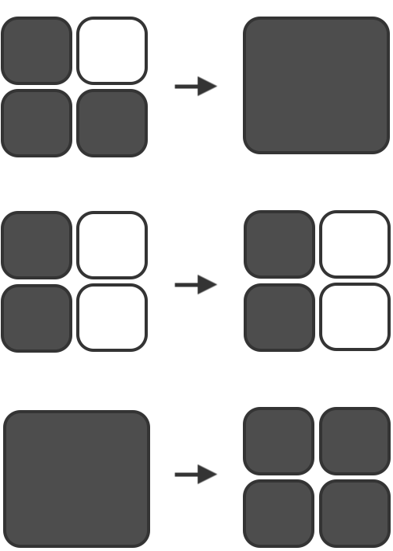
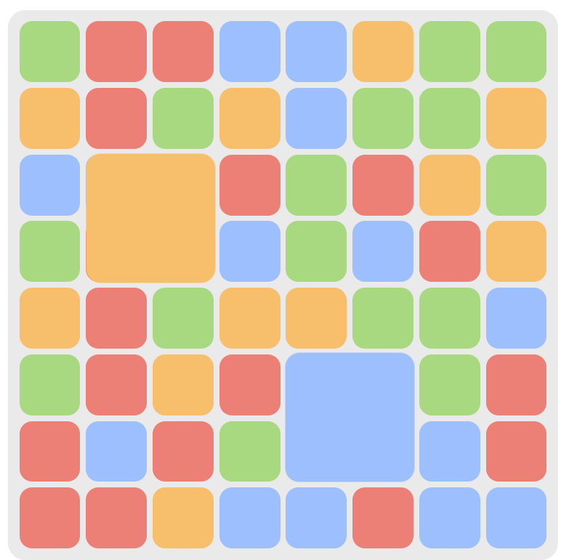
Vision
Tutorial
Game
Notes:
Jacob

Slide 5
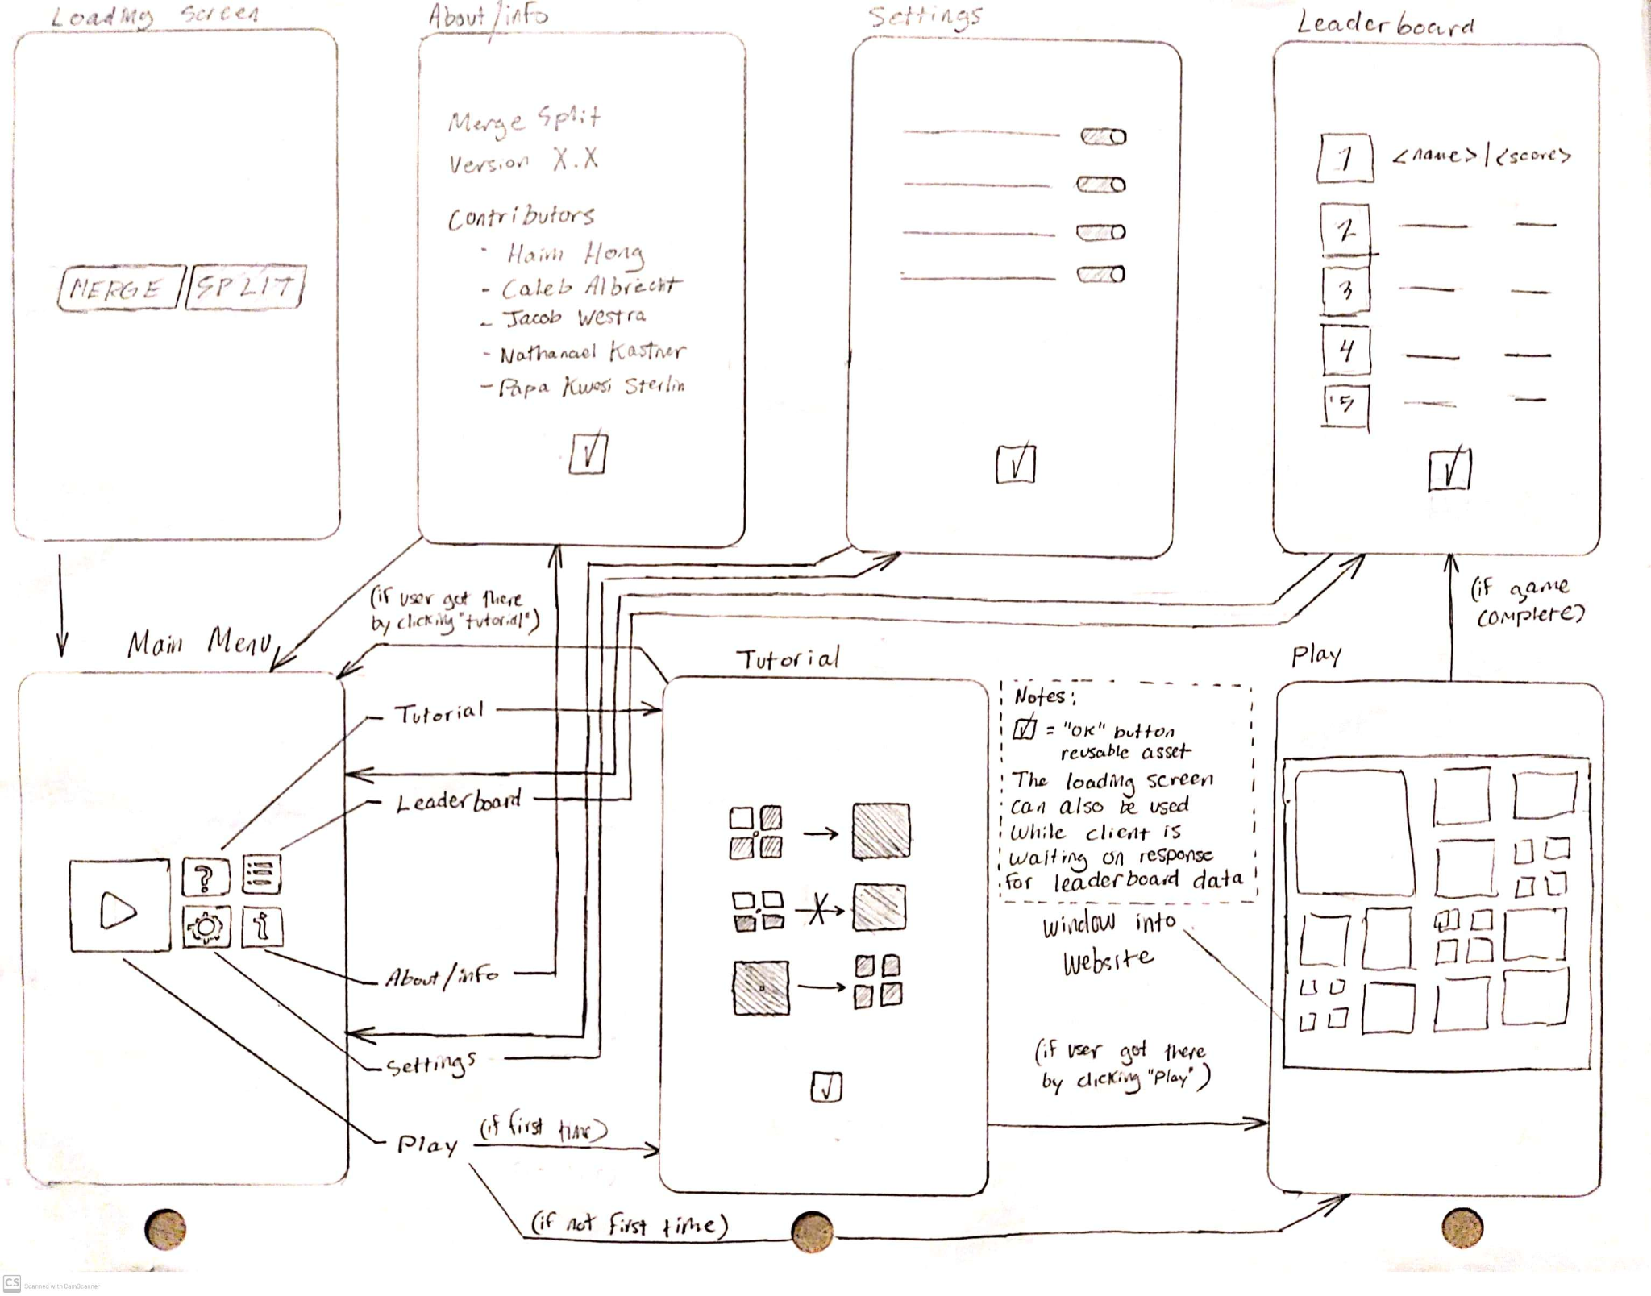
UI Design
Notes:
Caleb

Slide 6
Analysis & Design
Application Domain
Intended for people desiring competition
Intended for younger people
For students who want a short study break
Notes:
Nathanael

Slide 7
Analysis & Design
Key User Stories:
Calvin student plays MergeSplit
User views score after game
Notes:
Nathanael

Slide 8
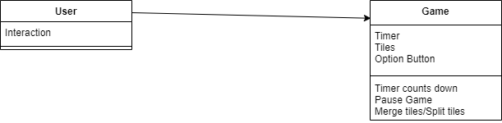
Analysis & Design
Database Schema
Player
Game Instance
Player Scores
Game Type (a possibility)
Domain Model
Notes:
Nathanael

Slide 9
Status report
To-do
Generate winnable (not random) tile set
Scoring system (time-based?)
Database implementation
Done
Base game
Title screen
Tutorial
App screens (settings, about, etc.)
Notes:
Jacob

Slide 10
Q&A
We want your feedback!
Notes:
Jacob

